Slide 1

The Battle of Neighborhoods
Restaurants in Sri Lanka

Slide 2
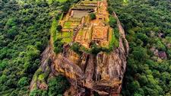
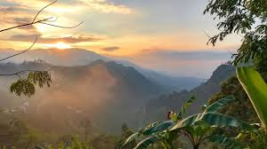

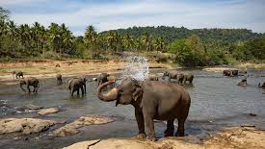
Introduction
Sri Lanka is a beautiful place for tourists as well as local travelers. Every person traveling need a good place to have meals. This project is to find the places and type of restaurants to have favorite meal

Slide 3
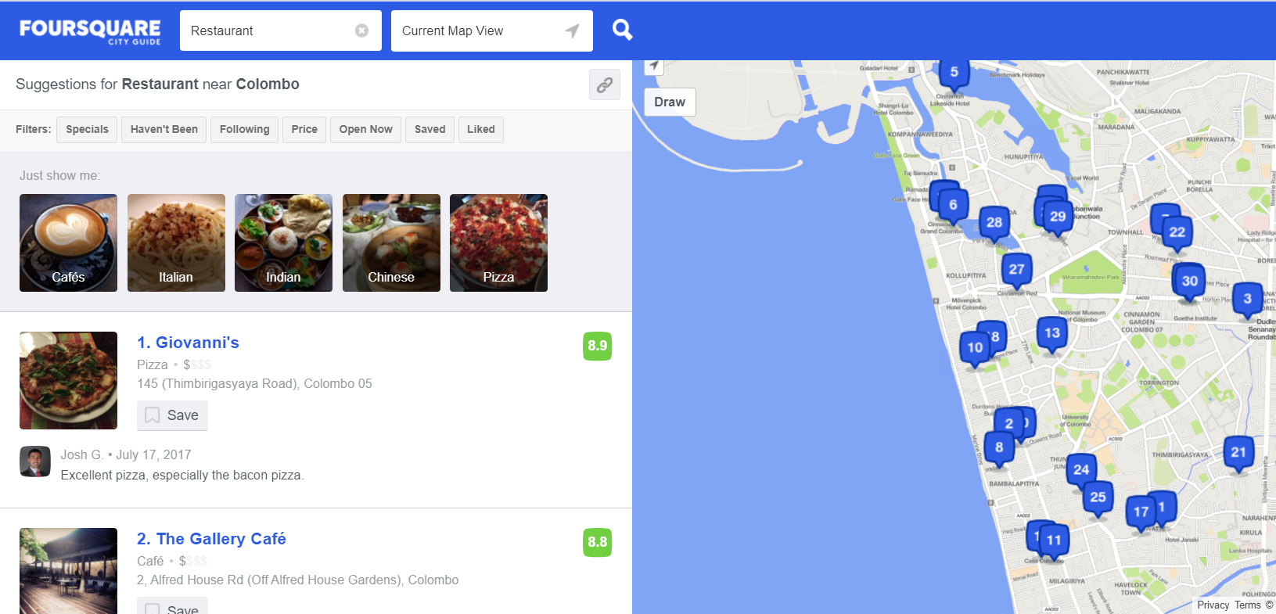
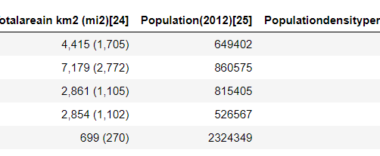
Data
Here we used two type of data sources
Wikipedia – To get Sri Lanka Districts details
Foursqure.com – To get venues data

Slide 4
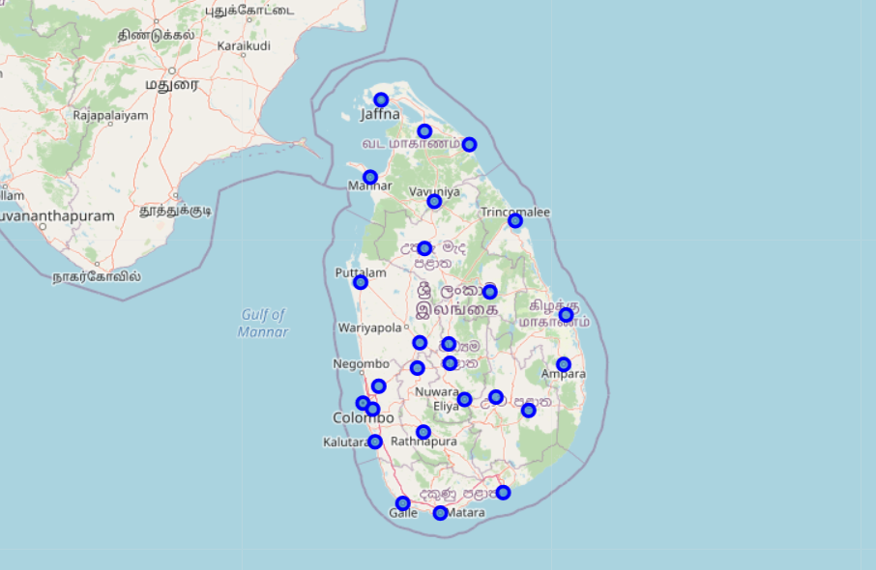
Districts of Sri Lanka
Here we can see the 25 districts of Sri Lanka mapped on Sri Lanka Geographical map.

Slide 5
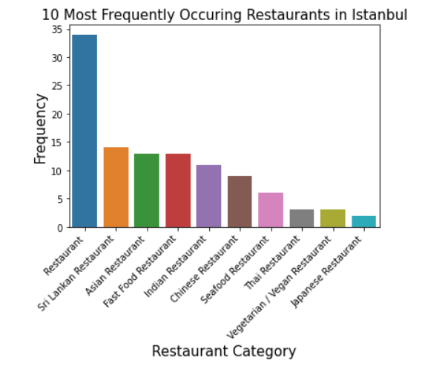
118 Restaurants were found, and these restaurants are belonging to 19 different categories.
As showing in the graph Common type restaurants are have most entries compare to the others.
Sri Lankan Restaurants, Asian Restaurants and Fast-food restaurants took next three places

Slide 6
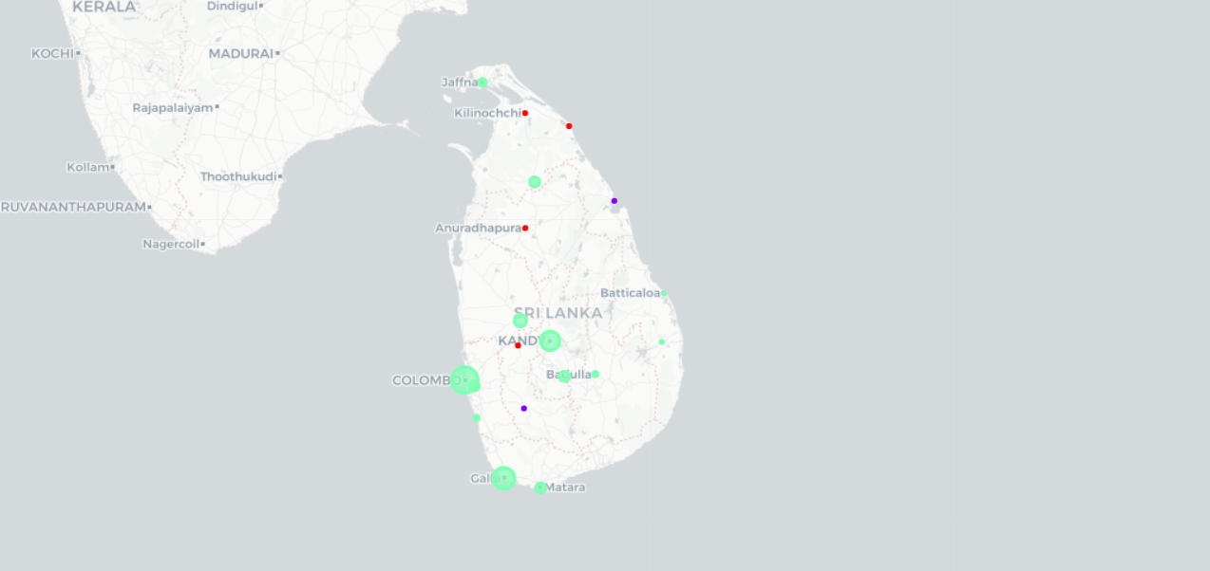
After Clustering we got theses results as shown in map
Green Color – Most of the common restaurants can be found in these areas compare to the other areas
Red color – In these areas we can find Sri Lankan Restaurants which will provides Sri Lankan local foods
Purple color – In these areas most common type is Fast-food restaurants compare to others

Slide 7

Most of the common restaurants can be found compare to the types of Restaurants
Since Data availability for Sri Lanka is small, these clustering can be differ with real scenario
To get more accurate recommendation system, need to collect more data in each area.
Conclusion

